Slide 1

ENERGY CONSUMPTION ANALYSIS
NAME: RAMYA KRISHNAN A
COURSE: DATA SCIENCE
BATCH CODE: DW75DW76

Slide 2
DOMAIN AND TECHNOLOGY
Technologies Used:
Data Cleansing, Exploratory Data Analysis (EDA), Visualization (Power BI)
Domain:
Energy and Sustainability

Slide 3
PROBLEM STATEMENT
Ontario's Broader Public Sector (BPS) faces challenges in optimizing energy usage and reducing greenhouse gas (GHG) emissions. To address this, our project aims to analyze data spanning from 2012 to 2020, focusing on BPS organizations like public hospitals and school boards. The key objectives include identifying energy consumption trends, evaluating conservation effectiveness, and pinpointing areas for improvement. Through comprehensive data preparation, cleansing, and exploratory data analysis using Power BI, we seek to uncover insights, correlations, and outliers. The ultimate goal is to inform data-driven strategies that contribute to achieving climate change mitigation goals within the BPS. Our presentation will showcase these findings through compelling visualizations, facilitating informed decision-making for a more sustainable future.

Slide 4
INTORDUCTION
Brief overview of sustainability goals in the Broader Public Sector (BPS)
Environmental Impact:
Highlight the broader environmental impact of energy consumption and greenhouse gas emissions within the BPS.
Public Accountability:
Discuss the role of transparency and accountability in the public sector, emphasizing the need for data-driven insights to showcase progress and areas for improvement.
Significance of data analysis and visualization for achieving these goals

Slide 5
DATA CLEANING PROCESS
Methods Used:
Handling NaN Values: Discuss how missing values were addressed to ensure data completeness.
Adding a Year Column: Explain the addition of a year column to facilitate temporal analysis.
Standardizing Column Names: Highlight the importance of uniformity by standardizing column names for consistency.
Facilitation for Analysis:
Emphasize that these cleaning steps were essential for preparing the dataset for subsequent analysis in Power BI.

Slide 6
POWER BI DASHBOARD

Slide 7
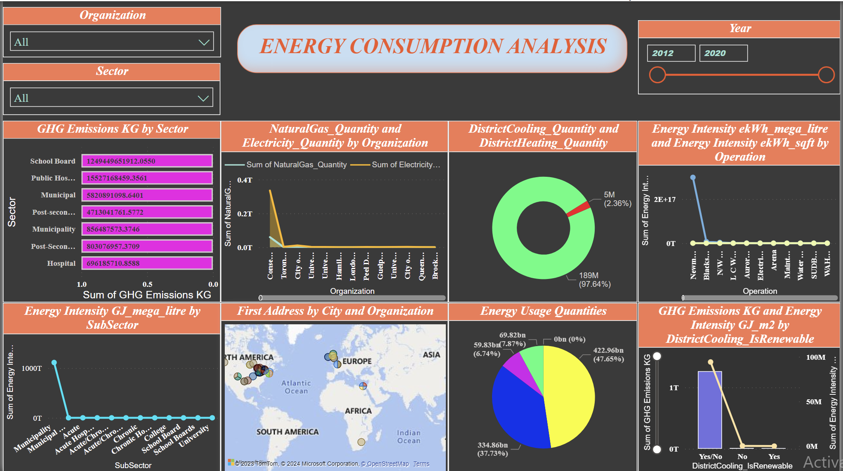

Slide 8
Filters
Interactive Features:
Implemented a user-friendly dropdown filter for organizations and sectors, providing viewers with the flexibility to select specific entities of interest.
Temporal Exploration:
Integrated a slider for the years 2012 to 2020, enabling dynamic temporal analysis and allowing viewers to focus on insights from specific time periods.
Customized Data Views:
Empowered viewers to tailor their experience by utilizing the dropdown and slider functionalities, ensuring a personalized exploration of the dataset.
User-Centric Design:
Designed the interactive features to enhance user engagement, allowing them to filter and extract specific insights based on their preferences and areas of interest.

Slide 9
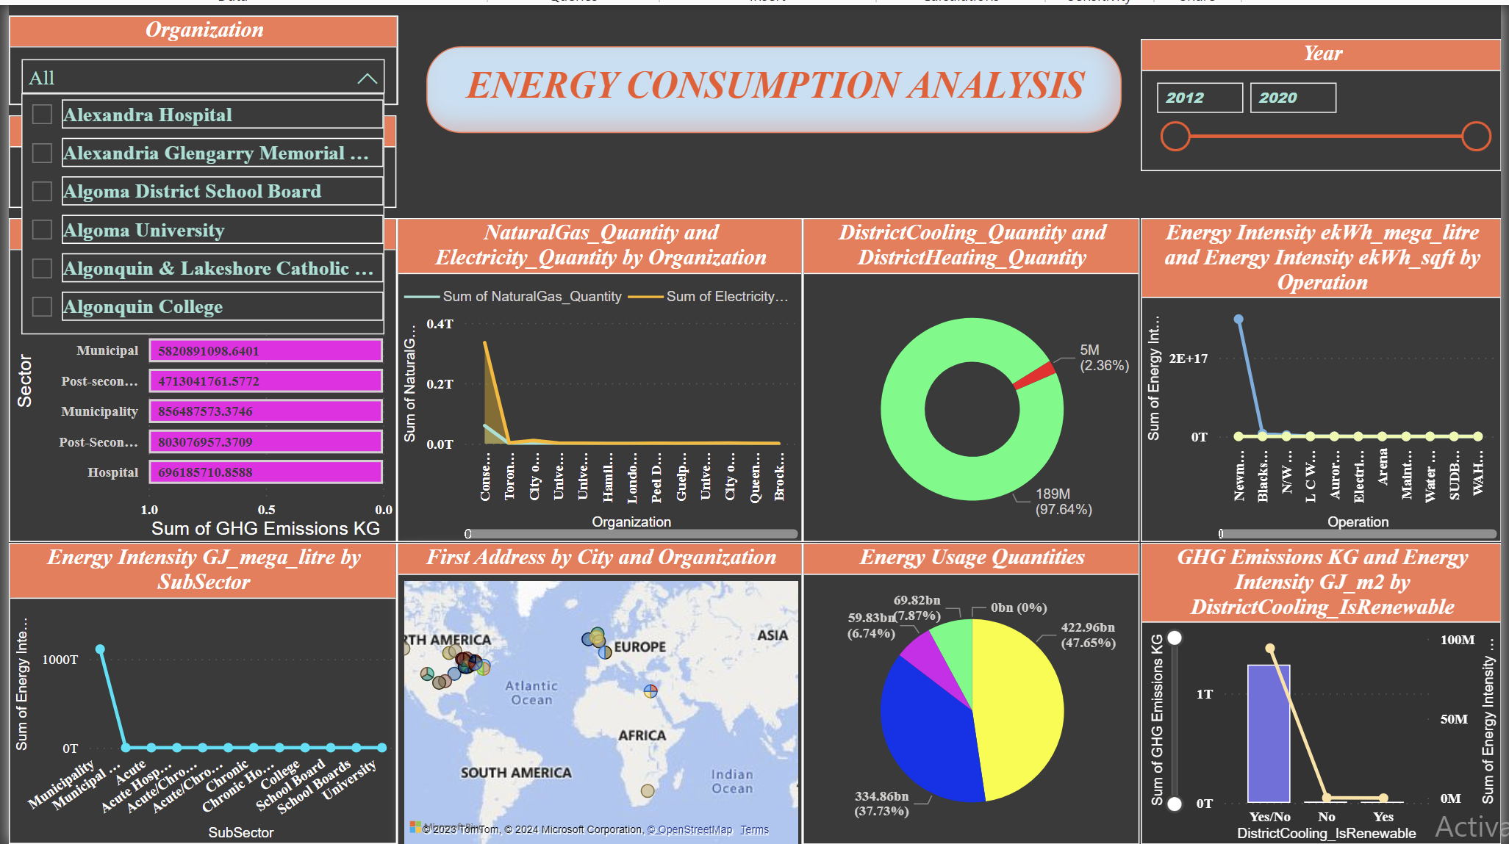
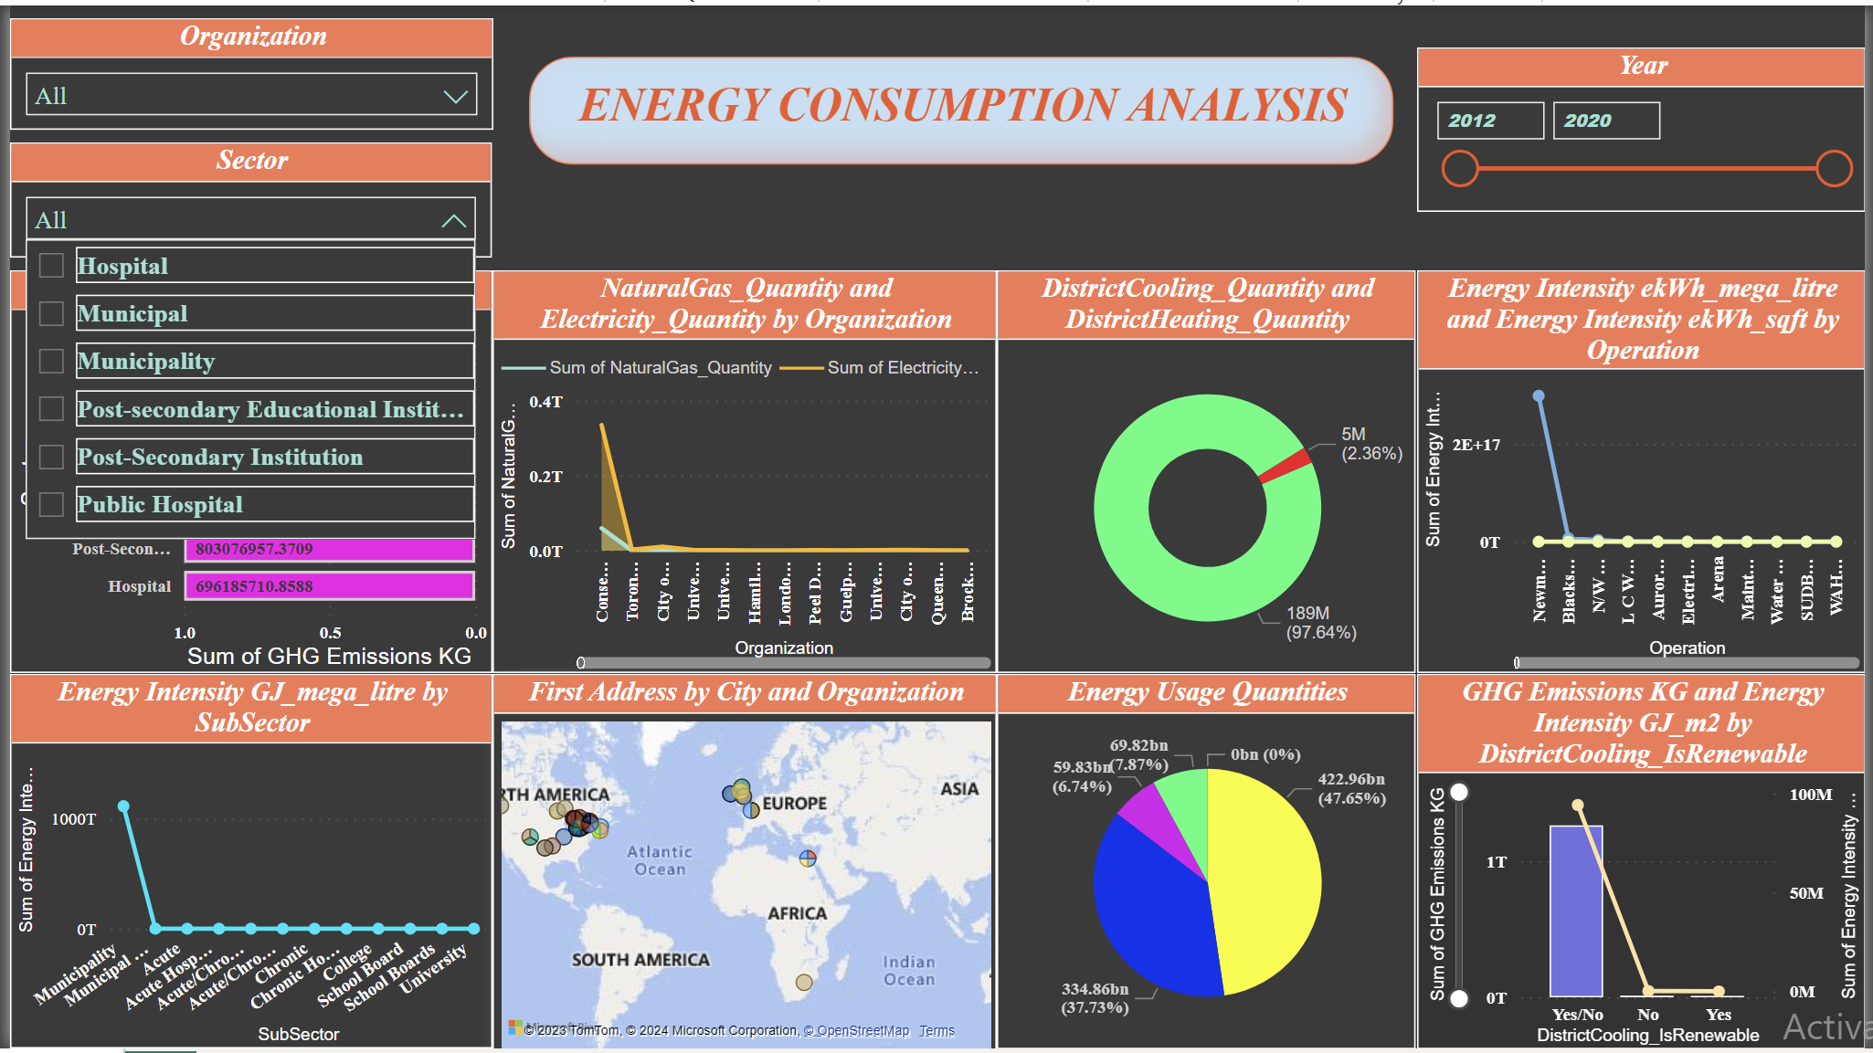

Slide 10
GHG Emission by Sector – Bar Chart
Chart Description:
Display a bar chart illustrating GHG emissions by sector.
Interactive Feature:
Overlapping Data: Mention that the chart allows viewers to overlap data, revealing the cumulative sum of GHG emissions in a particular sector as viewers hover over or select specific bars.
Insights:
Communicate that this interactive feature enhances the understanding of the total GHG emissions within each sector, promoting a more detailed analysis.

Slide 11
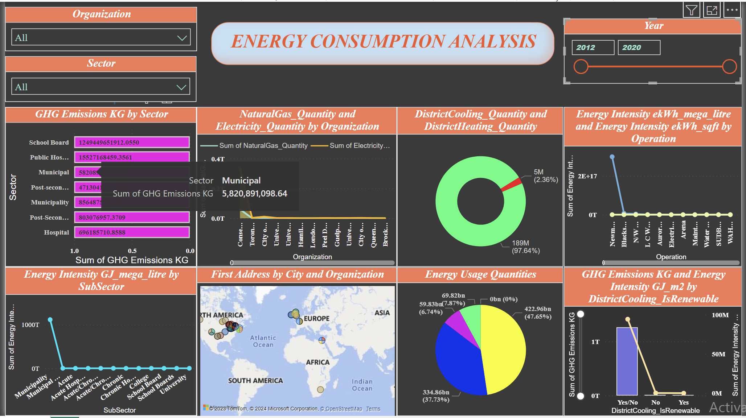

Slide 12
Natural Gas and Electricity Consumption – Line Chart
Chart Description:
Display a line chart illustrating natural gas and electricity consumption by organization.
Interactive Feature:
Overlapping Data: Highlight that as viewers overlap on the chart, they can see the cumulative sum of natural gas and electricity consumption by a specific organization. The blue line represents the sum of natural gas, and the yellow line represents the sum of electricity.
Insights:
Convey that this interactive feature provides a detailed overview of the energy consumption patterns for individual organizations, aiding in identifying high-consuming entities.

Slide 13
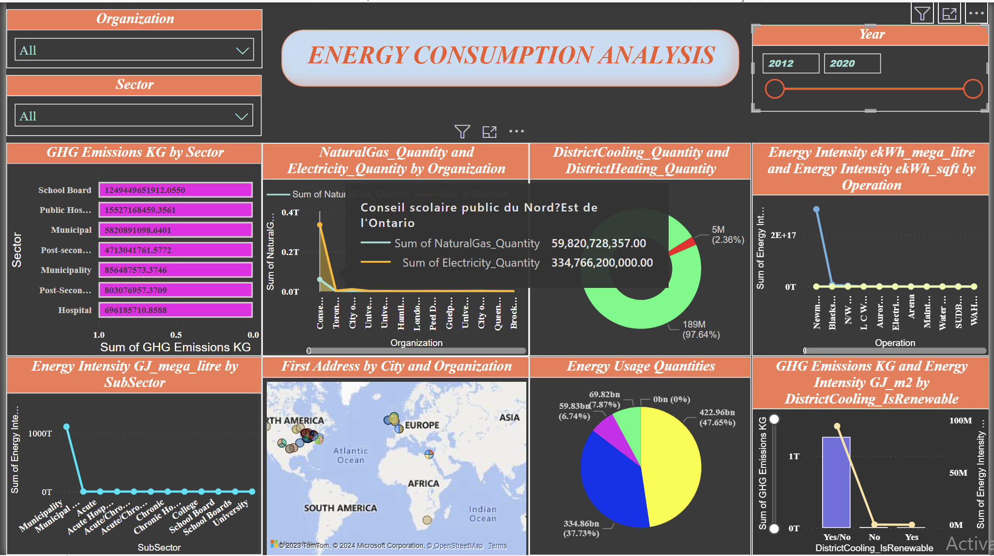

Slide 14
District Cooling and Heating – Donut Chart
Chart Description:
Present a donut chart illustrating district cooling (red) and district heating (green).
Interactive Feature:
Overlapping Data: Communicate that as viewers overlap on the donut chart, they can observe the cumulative sum of district cooling (red) and district heating (green).
Insights:
Convey that this interactive feature allows for a comprehensive understanding of the balance between district cooling and heating, aiding in weather-related energy consumption insights.

Slide 15


Slide 16
Energy Usage Quantities – Pie Chart
Chart Description:
Present a pie chart illustrating energy usage quantities for various sources.
Interactive Feature:
Overlapping Data: Explain that as viewers overlap on the pie chart, they can observe the cumulative sum of energy quantities. Natural gas is represented in green, propane, coal, wood, and fuel oil12 in blue, fuel oil46 in pink, and electricity in yellow.
Insights:
Convey that this interactive feature enables a detailed exploration of the distribution of energy sources, providing insights into the predominant contributors.

Slide 17
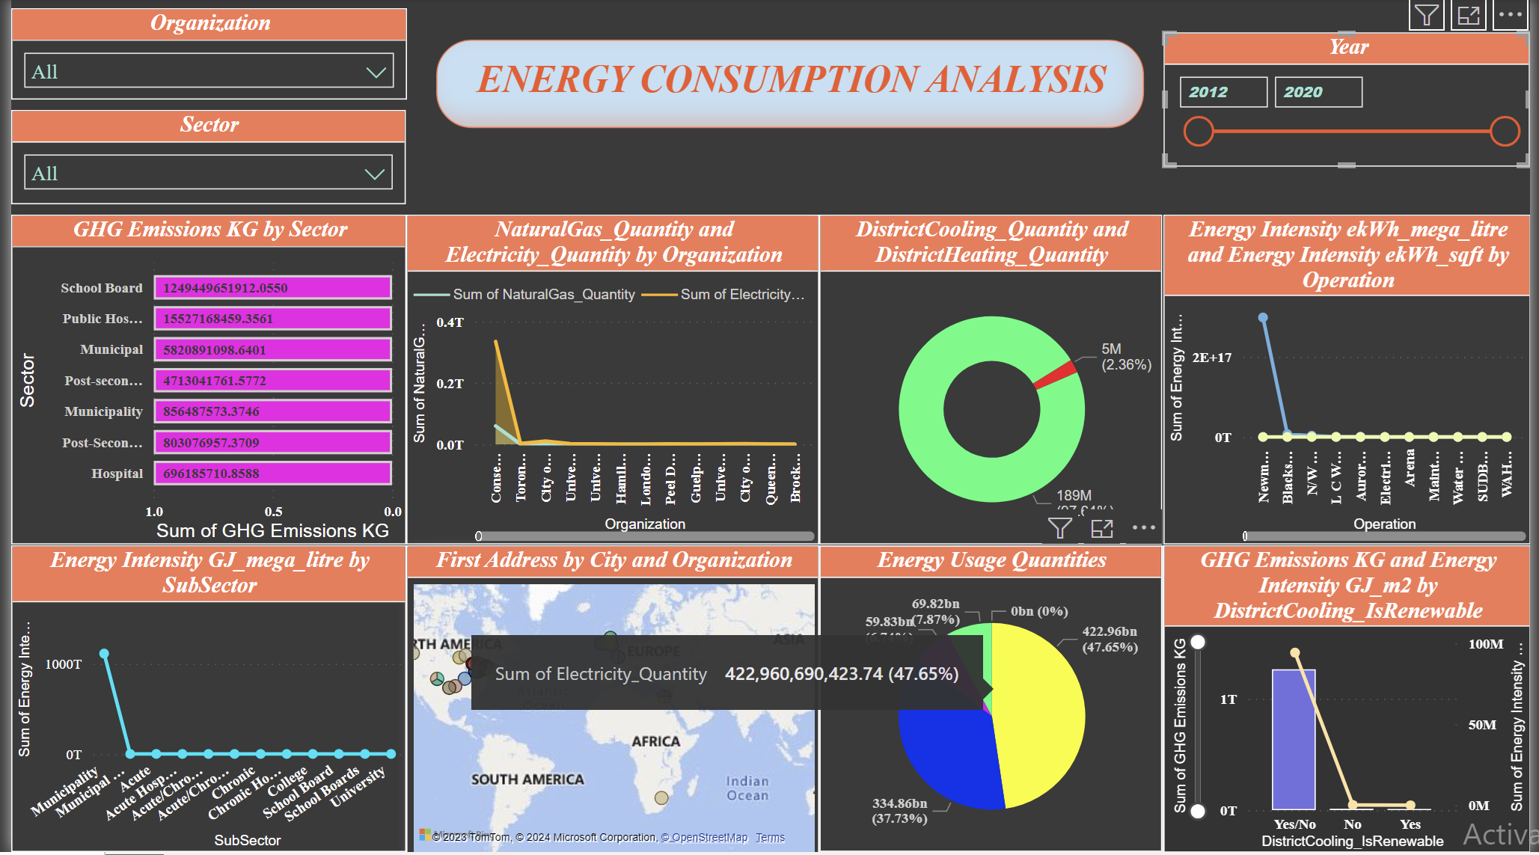

Slide 18
Energy Intensity by Operation – Line Chart
Chart Description:
Present a line chart illustrating energy intensity by operation, with blue representing Mega litre and yellow representing sqft.
Interactive Feature:
Overlapping Data: Describe that as viewers overlap on the line chart, they can observe the cumulative sum of energy intensity for Mega litre (blue) and sqft (yellow).
Insights:
Convey that this interactive feature facilitates a detailed examination of energy intensity trends across different operations, highlighting variations in Mega litre and sqft.

Slide 19
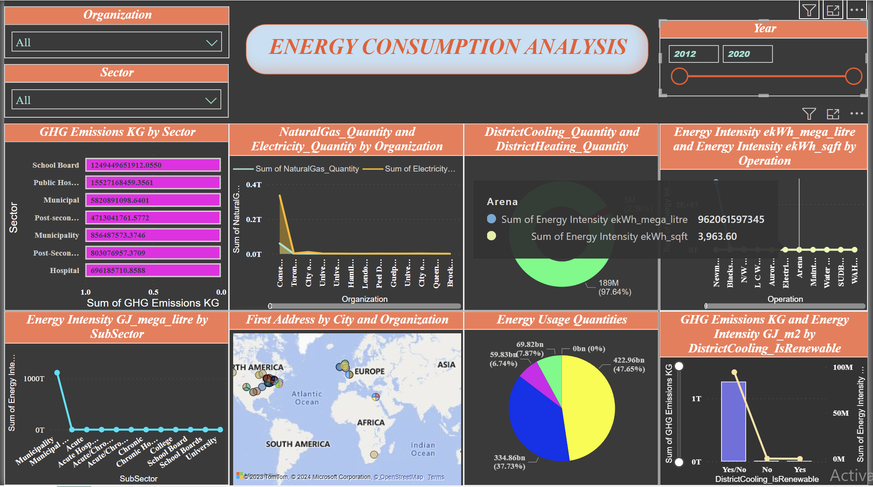

Slide 20
GHG Emissions and Energy Intensity - Line and Clustered Column Chart
Chart Description:
Showcase a line and clustered column chart illustrating GHG emissions (column) and energy intensity GJ_m2 by district cooling renewable (line).
Interactive Feature:
Overlapping Data: Explain that as viewers overlap on the chart, they can observe the cumulative sum of GHG emissions by column, while the line indicates the energy intensity of GJ_m2 by district cooling renewable.
Insights:
Convey that this interactive feature allows for a comprehensive view of the relationship between GHG emissions and energy intensity, emphasizing the impact of district cooling renewable sources.

Slide 21
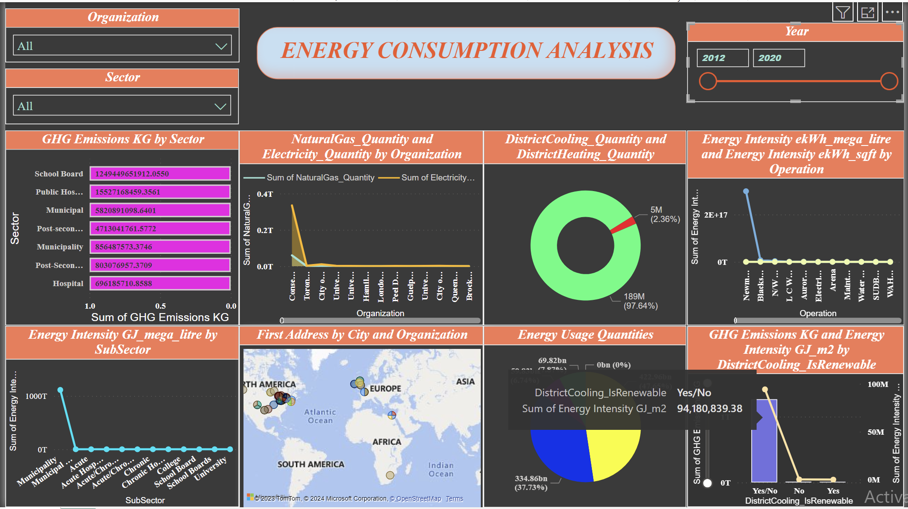

Slide 22
Geographical Distribution - Map
Chart Description:
Display a map showcasing the geographical distribution of organizations.
Interactive Feature:
Overlapping Data: Communicate that as viewers overlap on the map, they can observe the address, city, and organization name for each specific location.
Insights:
Convey that this interactive feature provides a visual representation of the spatial distribution of organizations, allowing for geographical insights.

Slide 23
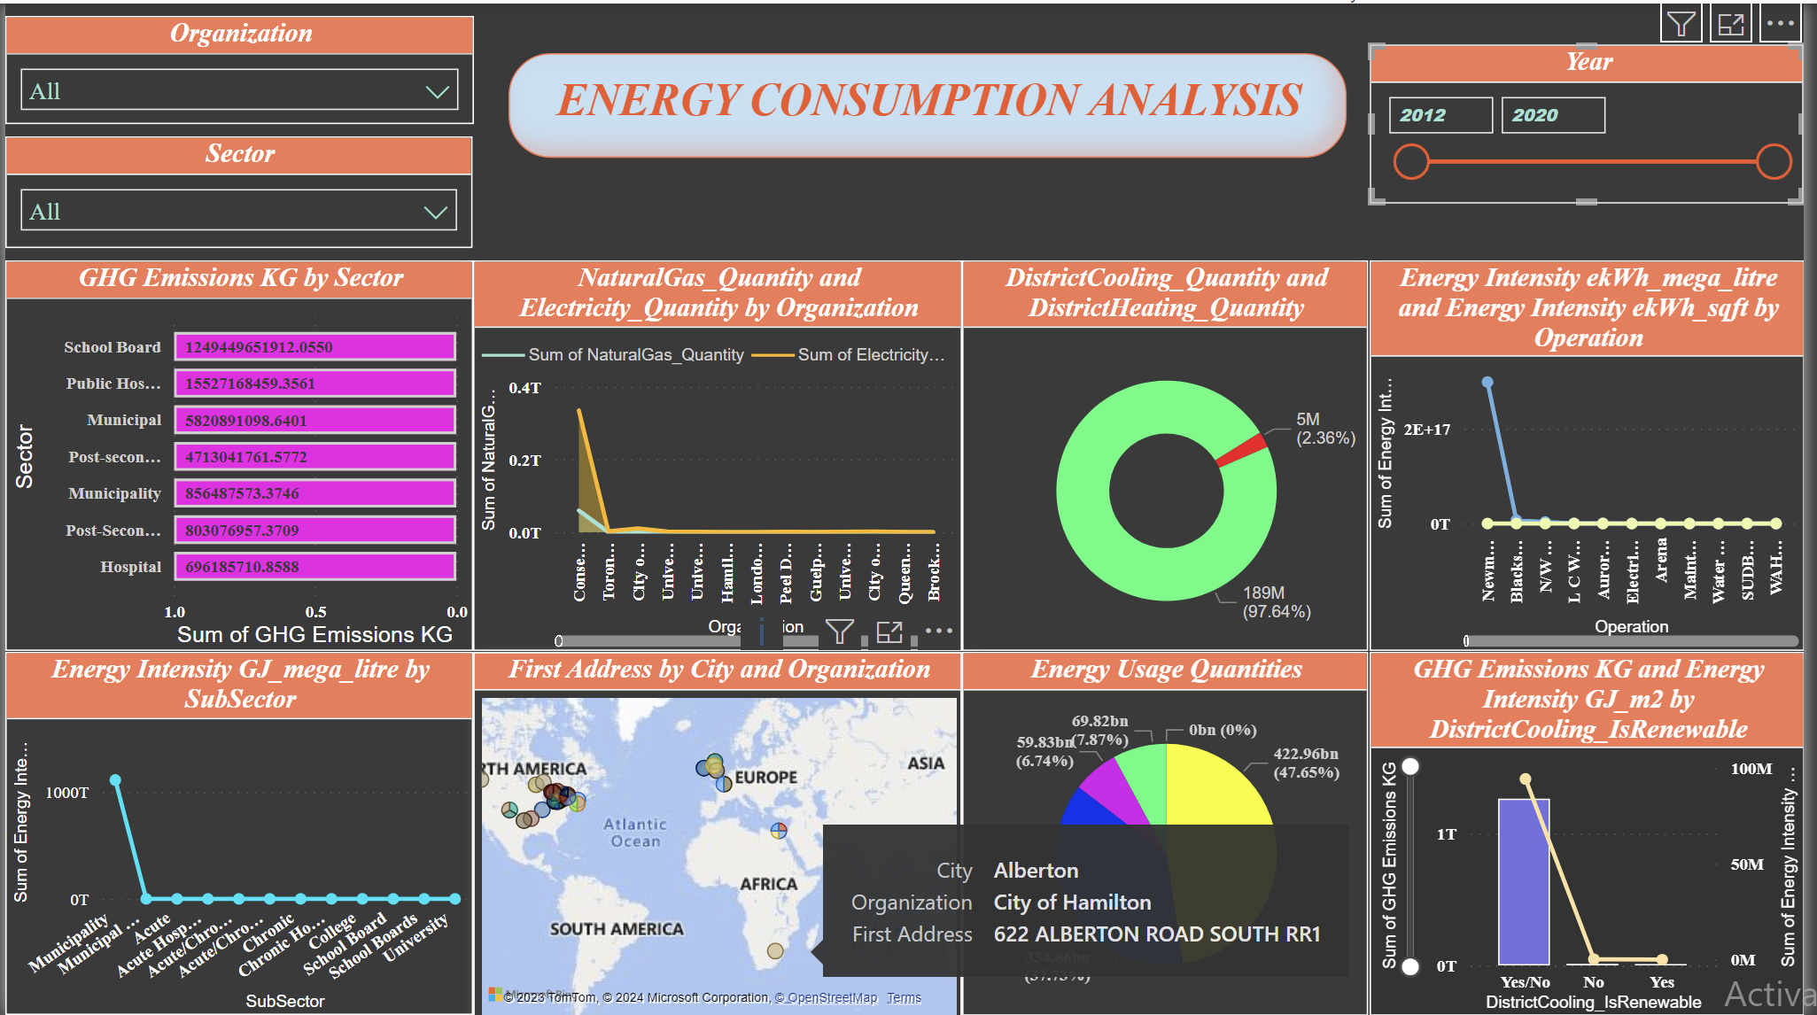

Slide 24
Energy Intensity GJ Mega Litre by Subsector – Line Chart
Chart Description:
Present a line chart illustrating energy intensity in GJ per mega litre by subsector.
Interactive Feature:
Overlapping Data: Communicate that as viewers overlap on the line chart, they can observe the cumulative sum of energy intensity in GJ per mega litre, and it also displays the subsector name.
Insights:
Convey that this interactive feature allows for a detailed exploration of energy intensity trends across different subsectors, providing insights into variations and patterns.

Slide 25
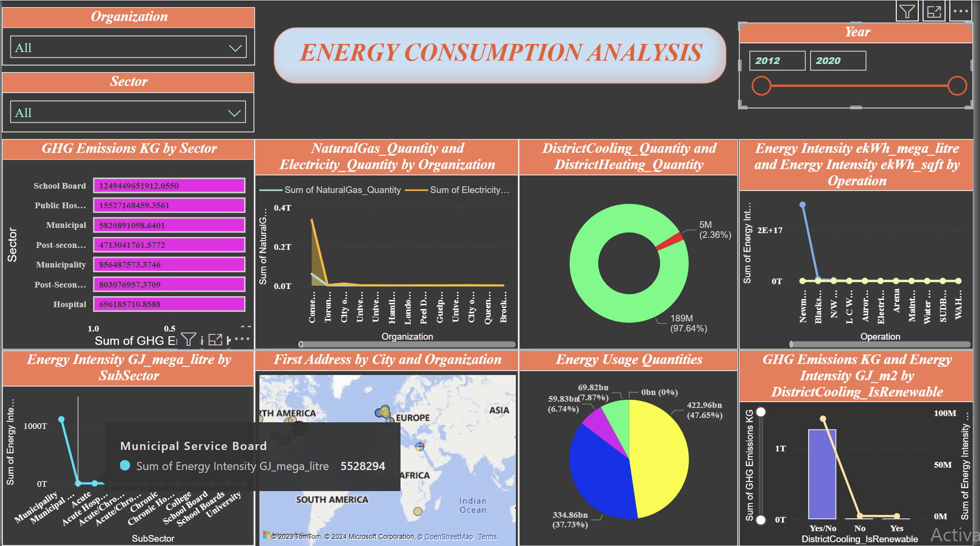

Slide 26
Conclusion:
Data Challenges Overcome:
Successful navigation through intricate data challenges, ensuring data integrity and reliability.
Meticulous Data Handling:
Detailed data cleaning and consolidation processes performed with precision.
Insights Unveiled:
Power BI visualizations uncovered trends in energy consumption, greenhouse gas emissions, and operational efficiency.
User-Empowered Dashboard:
Power BI dashboard designed for user-friendliness, empowering stakeholders to actively engage with data.

Slide 27
Conclusion
Deeper Understanding:
Stakeholders facilitated in gaining a deeper understanding of environmental impact, geographical distribution, and operational efficiency.
Foundation for Decision-Making:
Project findings establish a robust foundation for evidence-based decision-making and strategic planning.
Contribution to Climate Goals:
Insights contribute to climate change mitigation goals, guiding actions for a more sustainable future.
Strategic Impact:
The project's outcomes are instrumental in contributing to the broader sustainability agenda within Ontario's Broader Public Sector.

Slide 28


